Slide 1
Communication, Estimation & Negotiation
Rahul Mohandas

Slide 2
S1-25_SEZG509 Communication, Estimation & Negotiation
Session #8 – Sunday, 14 Sept 2025
Rahul Mohandas

Slide 3
Discussion Topics – Week 7
Estimation: Value Estimation
The need for estimation
Dimensions of value
Market estimates – TAM/ SAM/ SOM
Value estimation risks

Slide 4
Module 1 – Summary
Stakeholder Engagement
Need for Stakeholder Engagement to be Agile
Understand Your Audience
Categorizing stakeholders on Interest & Influence
Making time to engage with stakeholders
Internal & External stakeholders
Make time to understand the needs and pains of your stakeholders
4

Slide 5
Customer Advisory Board
Why do you need a Customer Advisory Board –
To advise you on strategy
Who should be part of it?
Key customers
Based on nature of relationship with you
Based on nature of relationship among themselves
How often should you meet?
Quarterly (more often if needed)
What should be the Agenda?
Validate findings/ approach
Validate roadmap
Identify blind spots/ gaps
5

Slide 6

CAB Driven Strategy
Expansion into Europe based on customer input
6
Notes:
Expansion from saturated US market to European market. Working together with existing US customers to target their EU operations. Win-Win - They get familiar proven product in EU, we get to grow our business. The countries to focus on decided in partnership with customers.

Slide 7

Partner Driven Strategy
Mid Market Expansion
7
Notes:
Expansion from Fortune 200 to Fortune 2000. Needed a sales team to reach the increased number of target customers and associated sales cycle. Partnered with an external agency to reach the customers.
Exclusivity contract with the partner for the 1st year to help the partner gain momentum.

Slide 8
Beta programs
Identify
Define success criteria
Train & onboard
Periodic touchpoints
Feedback templates
8

Slide 9
Progress Demos
Set context
Show & tell
Get feedback
Build excitement
9

Slide 10
Discussion Topics – Week 8
Communication Tips
Active listening
PREP Framework
Modes of communication
Working across cultures and time zones
Communication tips for introverts
Context switching through the day

Slide 11
Active Listening
Active listening is a communication technique that involves fully concentrating, understanding, responding, and remembering what is being said.
It goes beyond just hearing words, requiring the listener to be engaged with the speaker both verbally and non-verbally.
Active listening is crucial in building trust, fostering effective communication, and avoiding misunderstandings.

Slide 12

Techniques for Active Listening
Clarifying
Avoiding Interruptions
Using verbal affirmations
Body language
Paraphrasing
Summarizing

Slide 13
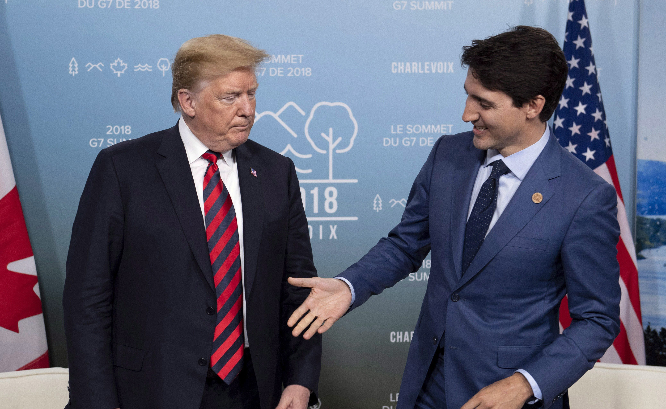
What Do You See?

Slide 14
Barriers to Active Listening
Distractions
Pre-judgement
Rehearsing a response
Information Overload
Emotional Interference

Slide 15
PREP Framework – Example
PREP | Example
Point | Implementing Slack in our team will significantly boost productivity.
Reason | This is because Slack streamlines communication, reduces the need for long email chains, and allows for real-time collaboration.
Example | For example, in our marketing team, we reduced internal email volume by 40% after switching to Slack, allowing the team to focus more on campaign execution.
Point | Therefore, adopting Slack will help us work more efficiently and improve overall team productivity.

Slide 16
PREP Framework – Example
PREP | Example
Point | I believe Google Ads is the most effective online advertising platform for small businesses.
Reason | This is because Google Ads allows businesses to target specific audiences based on demographics, search intent, and behavior, ensuring ads are shown to the most relevant users.
Example | For instance, a local bakery used Google Ads to target people searching for ‘fresh bread near me,’ and saw a 30% increase in foot traffic within a month.
Point | So, for small businesses looking to increase local visibility, Google Ads is an incredibly effective tool.

Slide 17
When You Think Of Reason
Think 5W 1H
Why
What
Who
Where
When
How

Slide 18
Breakout Room
Discuss the Benefits & Limitations of
Room 1 Email
Room 2 Slack/ Teams Channel
Room 3 Instant Message – Teams/ Whatsapp
Room 4 Audio only meeting
Room 5 Video meeting
Room 6 In person

Slide 19
Debrief

Slide 20
3 Key Elements
Words
Tone
Body Language

Slide 21
Email/ IM/ Channel
 | Pros | Cons
Email | Asynchronous Documentation Detail Wide reach- multiple recipients | Delayed response Miscommunication Overload Formal
Instant Message | Fast Informal Convenient Brief | Interruptive Lack of depth Limited record-keeping Expectation of immediate response Miscommunication
Slack Channel | Collaboration-focused Organized by topic Real-time interaction Integrations | Overwhelming Less structured Expectation for real-time responses Notification fatigue

Slide 22
Audio/ Video/ In-Person
 | Pros | Cons
Audio Call | Real time clarifications Tone Efficient Personal touch | No visual cues Interruptive No written record Technical issues
Video Call | Face-to-face interaction Engagement Screen share & Collaboration Relationship building | Time-consuming Technical challenges Fatigue Scheduling
In-Person Meeting | Personal connection Full engagement Collaborative environment Immediate feedback | Time-consuming Logistical challenges Costly Difficult to document

Slide 23




Takeaway
Use the Right Medium for the Situation

Slide 24
Working Across Cultures
Cultural Norms
Formality Levels
Simple language
Speak Slow & Clear
Patience

Slide 25
Working Across Time Zones
Plan Meetings
Rotate Meetings
Use Asynchronous Tools
Holidays & Working hours
Decision making

Slide 26
Tips For Introverts
Plan ahead
Put time on the calendar
Leverage written communication
Manage your energy
Use your strength – Listening

Slide 27

Context Switching Through The Day
Calendar
Plan ahead

Slide 28
Mid Term
Your Task
Put yourself in the shoes of Raj and prepare to navigate this situation.
You have been doing the course on Communication, Estimation & Negotiation. Use the relevant tools and frameworks that you have seen during the course.
Answer the following questions as Raj.
Important – Grading Policy :
For each question, up to 3% of the marks will be withheld by default. This will be awarded based on CRISPNESS:
Clear and concise - no fluff, only essentials
Bullet points - not long paragraphs
Well-articulated - logical, crisp, and professional
Structured and neat - easy to follow
Legible – if handwritten

Slide 29

Questions

